Slide 1
Lecture 4
Image formation using Lens
Camera Types and parameters for selection

Slide 2
Power of Lens
The power P of a lens is de¹ned to be the inverse of its focal length (f) in meters
P=1/f
The power of a lens P has the unit diopters (D), provided that the focal length is given in meters

Slide 3
Image formation using Lens
Rules for Ray Tracing
A ray entering a converging lens parallel to its axis passes through the focal point F of the lens on the other side
A ray passing through the center of either a converging or a diverging lens does not change direction
A ray entering a converging lens through its focal point exits parallel to its axis

Slide 4
Image formation using Lens

Slide 5
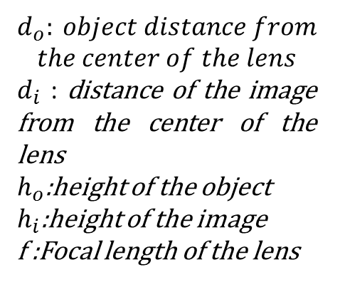
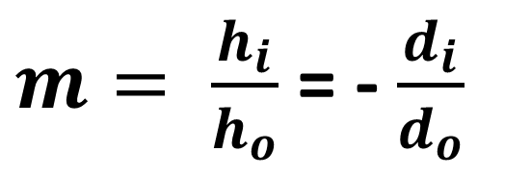
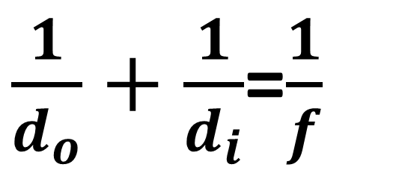
Lens Equation for image formation and magnification
$$d_{o}: object distance from$$
$$the center of the lens$$
$d_{i}$ : distance of the image from the center of the lens
$h_{o}$:height of the object
$h_{i}$:height of the image
f :Focal length of the lens
$\frac{1}{d_{o}}+$ $\frac{1}{d_{i}}$=$\frac{1}{f}$
$m= \frac{h_{i}}{h_{o}}$ = - $\frac{d_{i}}{d_{o}}$

Slide 6
Analogy with Human Eye

Slide 7
Two types of image formed by convex lens

Slide 8
Problems to Solve

Slide 9
Odd number Solutions

Slide 10
Camera Types
Interlaced vs. Progressive Scan Cameras
Area Scan vs. Line Scan Cameras

Slide 11
Interlaced vs. Progressive Scan Cameras
Conventional CCD cameras use interlaced scanning across the sensor.
The sensor is divided into two fields: the odd field (rows 1, 3, 5..., etc.) and the even field (rows 2, 4, 6..., etc.). These fields are then integrated to produce a full frame.
For most applications, interlaced scanning does not cause a problem.
However, some trouble can develop in high-speed applications because by the time the second field is scanned, the object has already moved.
This causes ghosting or blurring effects in the resulting image
Progressive scanning solves the high-speed issue by scanning the lines sequentially

Slide 12


Interlaced vs. Progressive Scan Cameras

Slide 13
Area Scan vs. Line Scan Cameras
In area scan cameras, an imaging lens focuses the object to be imaged onto the sensor array, and the image is sampled at the pixel level for reconstruction
This is convenient if the image is not moving quickly or if the object is not extremely large.
With line scan cameras, the pixels are arranged in a linear fashion, which allows for very long arrays
Long arrays are ideal because the amount of information to be read-out per exposure decreases substantially, as the object moves past the camera, the image is taken line by line and reconstructed with software

Slide 14
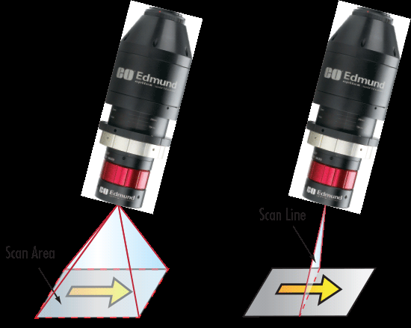
Area Scan vs. Line Scan Cameras

Slide 15
Important specifications for Camera Selection for vision based system

Slide 16
Field of View and Pixel Resolution
As a general rule, select a camera based on the size of the field of view and the pixel resolution.
The size of the field of view is the area captured on an inspection target, which can be changed by the lens used.
The pixel resolution means how many millimeters each pixel is equal to, and the relationship is expressed by the following equation
Pixel resolution = Size of field of view in the Y direction (mm) ÷ sensor pixel count in the Y direction

Slide 17
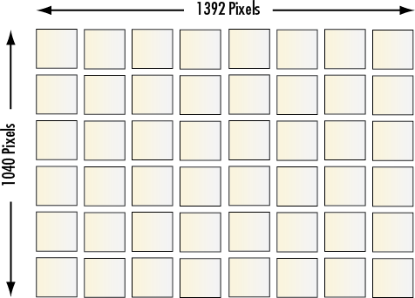
Example of pixels on the camera sensor

Slide 18
Pixel Count and Pixel size
The more pixels within a field of view (FOV), the better the resolution.
However, a large number of pixels requires either a larger sensor or smaller-sized individual pixels.
Using a larger sensor to achieve more pixels means the imaging lens magnification and/or or field of view will change

Slide 19
Frame Rate and Shutter Speed
The frame rate refers to the number of full frames (which may consist of two fields) composed in a second
In analog cameras, the frame rate is dictated by the display, digital cameras allow for adjustable frame rates.
The maximum frame rate for a system depends on the sensor readout speed, the data transfer rate of the interface including cabling, and the number of pixels (amount of data transferred per frame)
The shutter speed corresponds to the exposure time of the sensor & the exposure time controls the amount of incident light
In high-speed applications, it is beneficial to choose a faster frame rate to acquire more images of the object as it moves through the FOV.

Slide 20
Frame rate and pixel count
The number of pixels also affects the frame rate of the camera
For example, each pixel has 8-bits of information that must be transferred in the reconstruction of the image.
The more pixels on a sensor, the higher the camera resolution but lower the frame rate.

Slide 21
Sensor Size
The size of a camera sensor's active area is important in determining the system's field of view (FOV).
Given a fixed primary magnification (determined by the imaging lens), larger sensors yield greater FOVs.
There are several standard area-scan sensor sizes: ¼", 1/3", ½", 1/1.8", 2/3", 1" and 1.2", with larger available

Slide 22
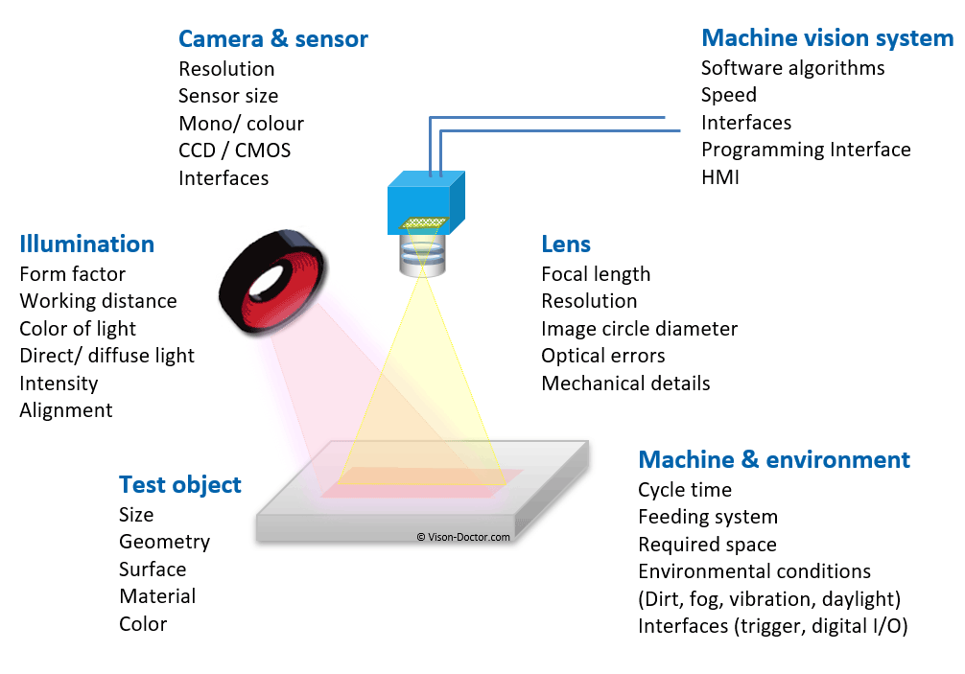
Selection criteria for a 2D machine vision system

